Slide 1
Domain Adaptation
John Blitzer and Hal Daumé III
TexPoint fonts used in EMF.
Read the TexPoint manual before you delete this box.: AAAAAAAAA

Slide 2
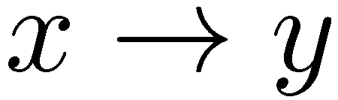
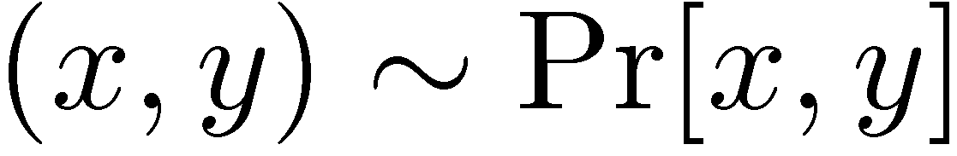

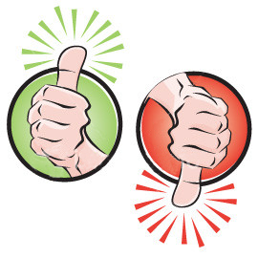


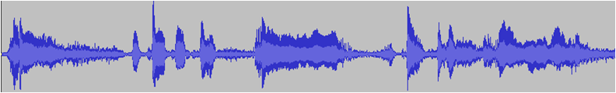
Classical “Single-domain” Learning
Predict:
Running with Scissors Title: Horrible book, horrible.
This book was horrible. I read half, suffering from a headache the entire time, and eventually i lit it on fire. 1 less copy in the world. Don't waste your money. I wish i had the time spent reading this book back. It wasted my life
So the topic of ah the talk today is online learning

Slide 3
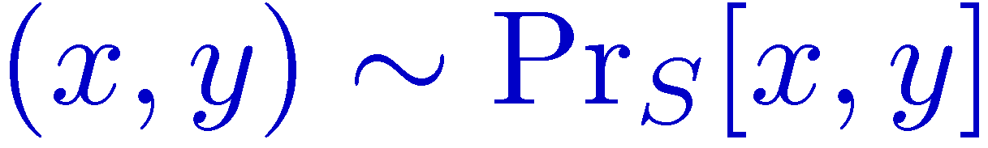
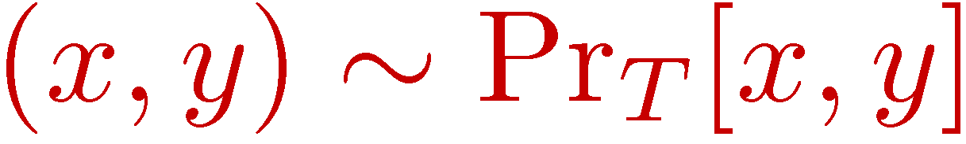

Domain Adaptation
Training
Source
So the topic of ah the talk today is online learning
Testing
Target
Everything is happening online. Even the slides are produced on-line

Slide 4

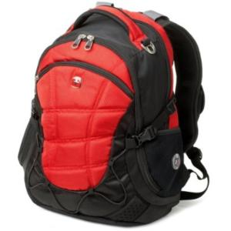
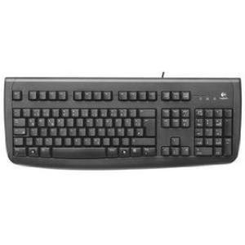

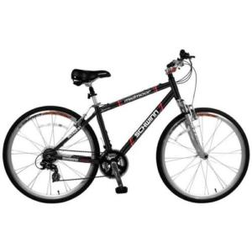


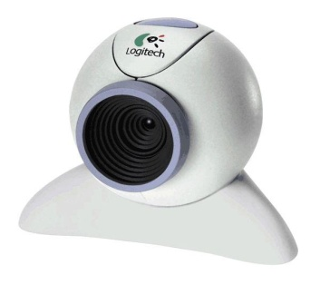
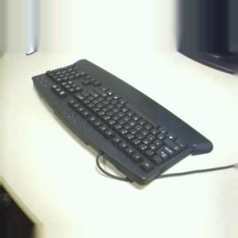
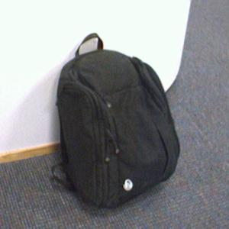

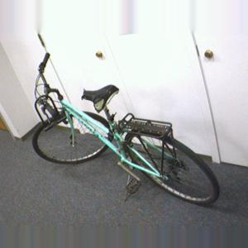
Domain Adaptation
Natural Language Processing
Visual Object Recognition
Packed with fascinating info
A breeze to clean up

Slide 5
Domain Adaptation
Natural Language Processing
Visual Object Recognition
Packed with fascinating info
A breeze to clean up
K. Saenko et al. Transferring Visual Category Models to New Domains. 2010.

Slide 6
Tutorial Outline
Domain Adaptation: Common Concepts
Semi-supervised Adaptation
Learning with Shared Support
Learning Shared Representations
Supervised Adaptation
Feature-Based Approaches
Parameter-Based Approaches
Open Questions and Uncovered Algorithms

Slide 7
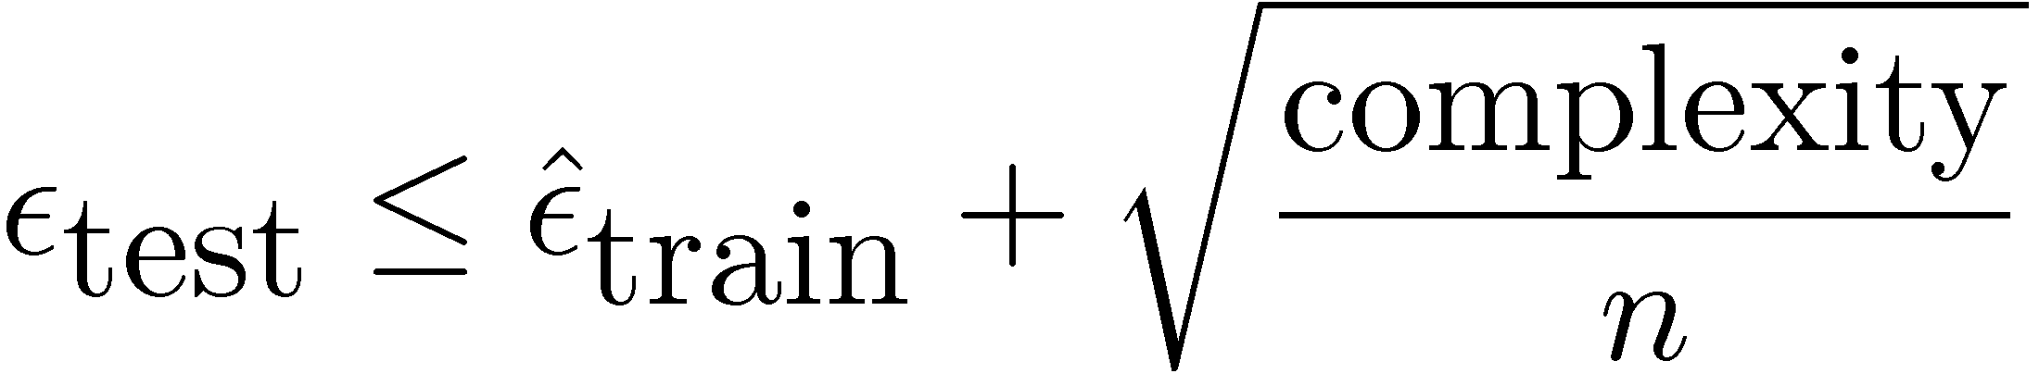

Classical vs Adaptation Error
Classical Test Error:
Measured on the
same distribution!
Adaptation Target Error:
Measured on a
new distribution!

Slide 8
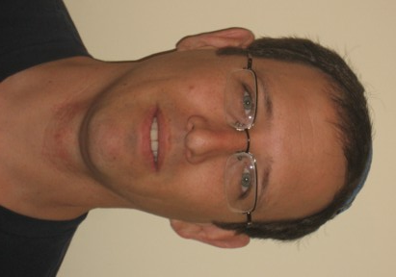

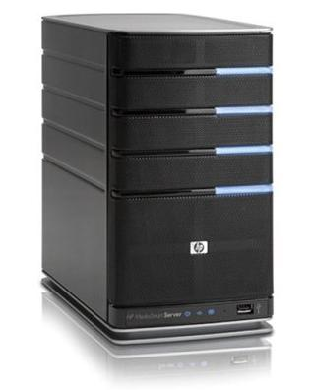
Common Concepts in Adaptation
Covariate Shift
understands both &
Single Good Hypothesis
understands both &
Easy
Hard
Domain Discrepancy and Error

Slide 9
Tutorial Outline
Notation and Common Concepts
Semi-supervised Adaptation
Covariate shift with Shared Support
Learning Shared Representations
Supervised Adaptation
Feature-Based Approaches
Parameter-Based Approaches
Open Questions and Uncovered Algorithms

Slide 10
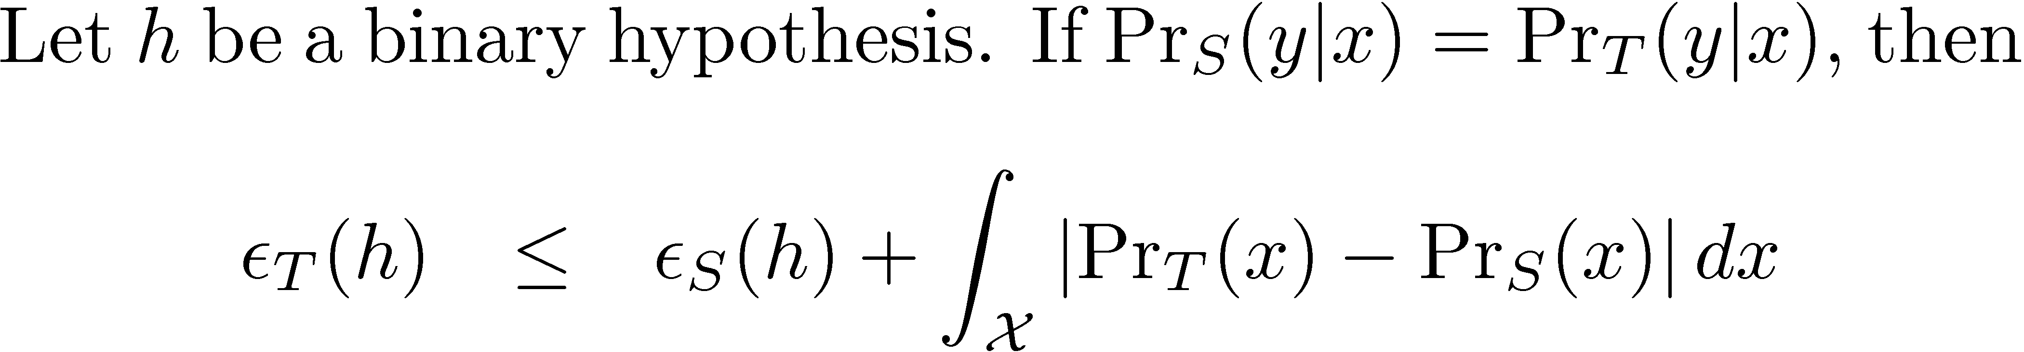
A bound on the adaptation error
Minimize the total variation

Slide 11
Covariate Shift with Shared Support
Assumption: Target & Source Share Support
Reweight source instances to minimize discrepancy

Slide 12
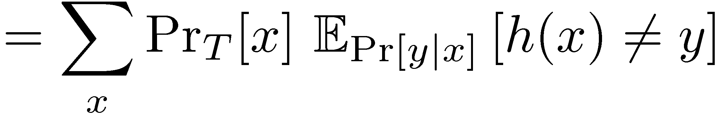
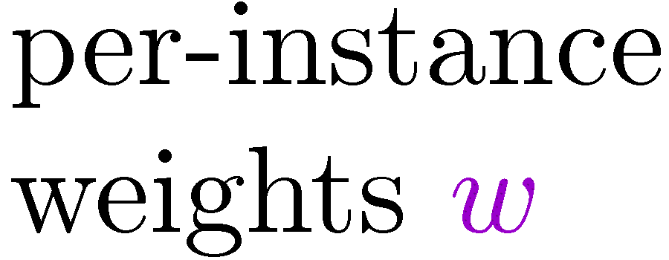
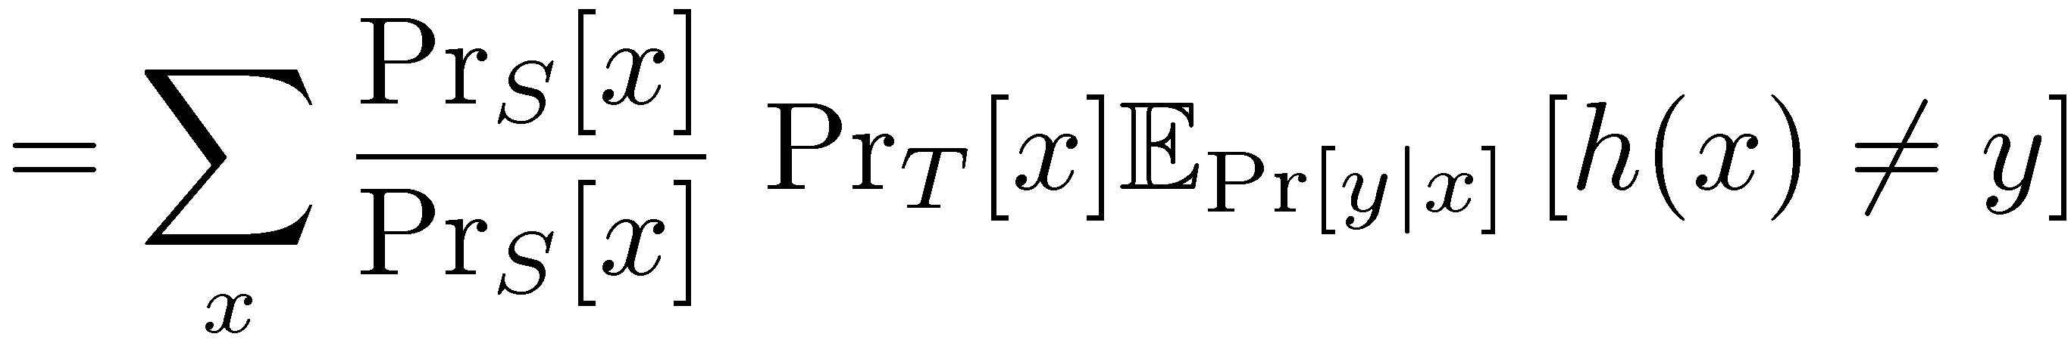
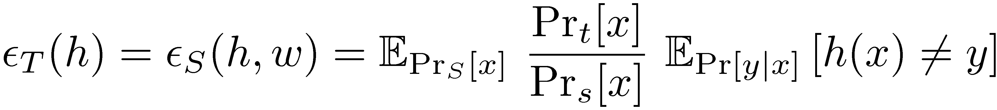
Source Instance Reweighting
Defining Error
Using Definition of Expectation
Multiplying by 1
Rearranging

Slide 13

Sample Selection Bias
Another Way to View
Draw from the target

Slide 14


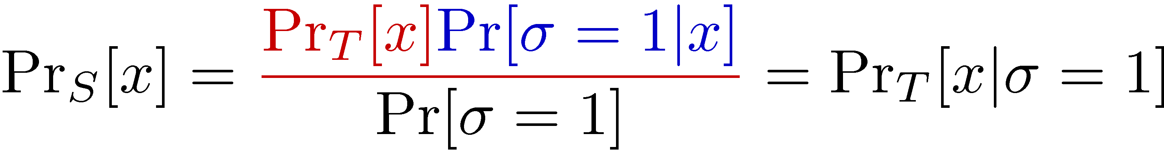
Sample Selection Bias
Redefine the source distribution
Draw from the target
Select into the source with

Slide 15
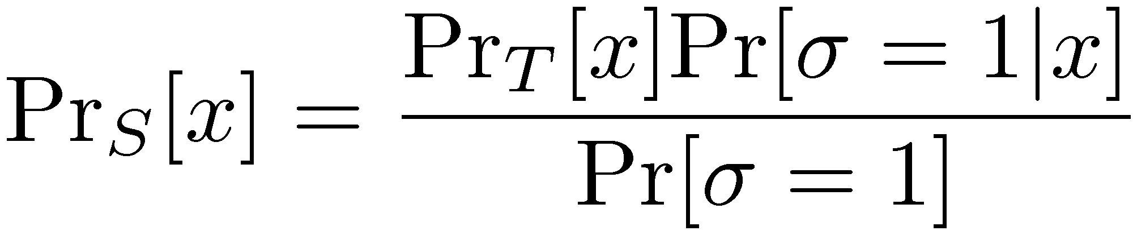
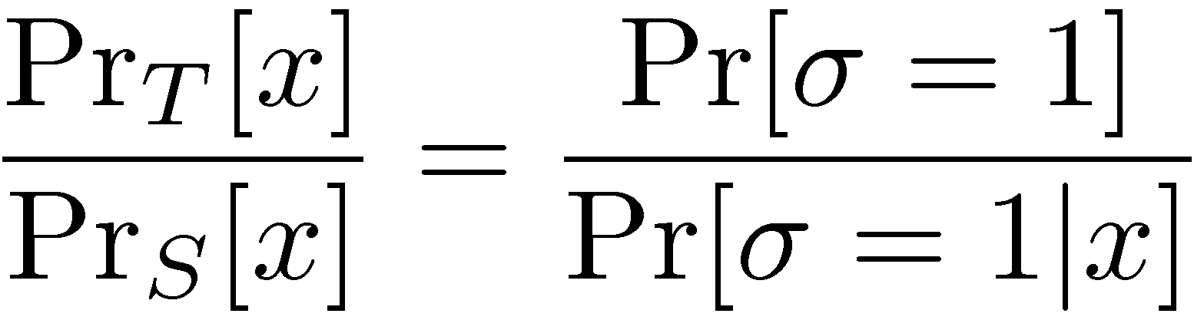
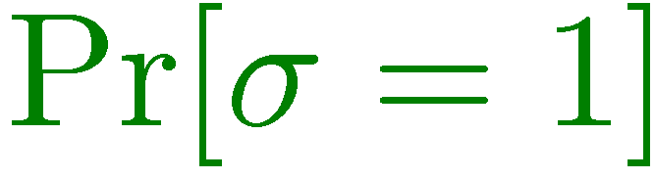
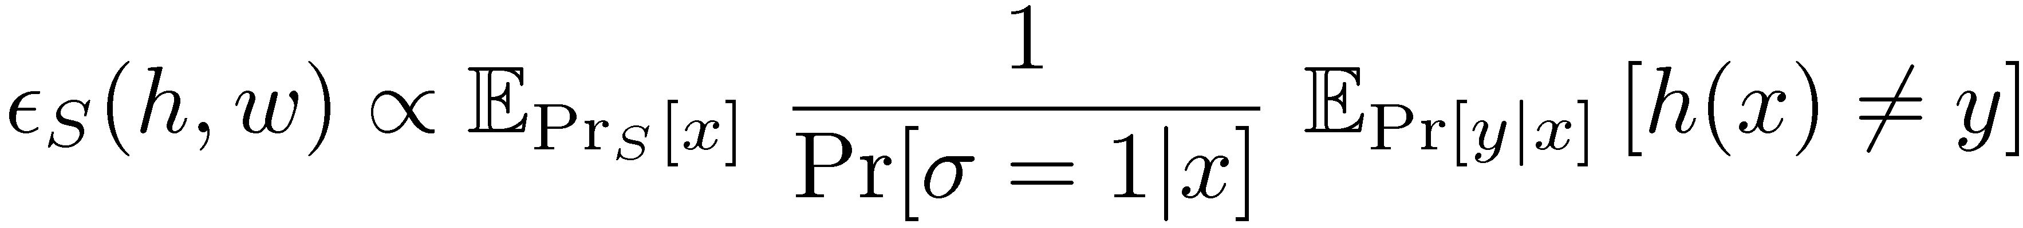
Rewriting Source Risk
Rearranging
not dependent on x

Slide 16
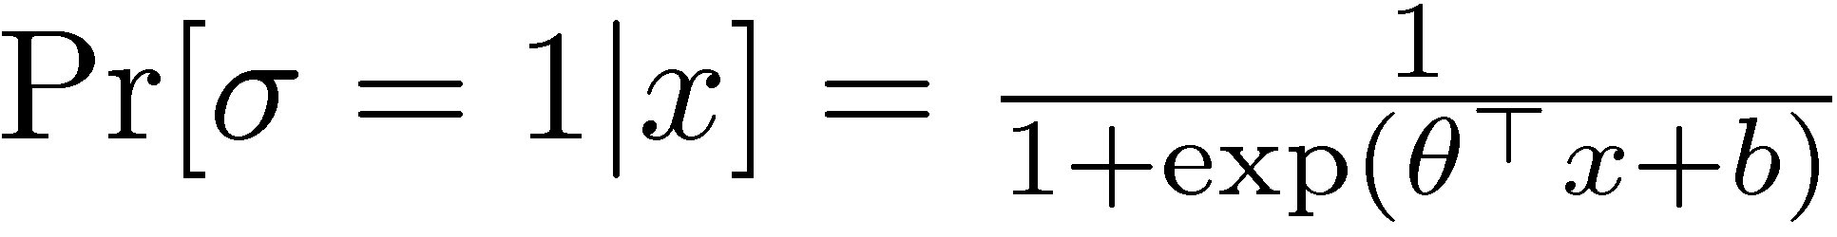
Logistic Model of Source Selection
Training Data

Slide 17
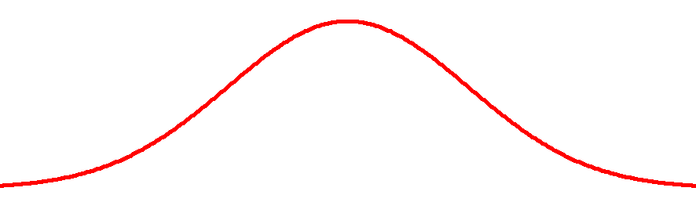
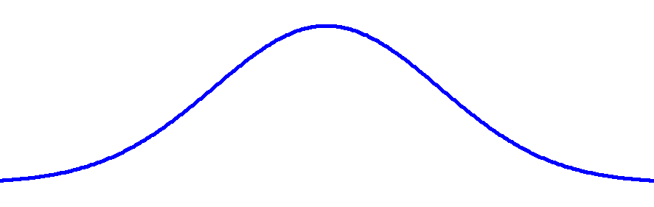
Selection Bias Correction Algorithm
Input:
Labeled source data

Slide 18
Selection Bias Correction Algorithm
Input:
Labeled source data
Unlabeled target data

Slide 19


Selection Bias Correction Algorithm
Input: Labeled source and unlabeled target data
1) Label source instances as , target as

Slide 20

Selection Bias Correction Algorithm
Input: Labeled source and unlabeled target data
Label source instances as , target as
Train predictor

Slide 21

Selection Bias Correction Algorithm
Input: Labeled source and unlabeled target data
Label source instances as , target as
Train predictor
Reweight source instances

Slide 22
Selection Bias Correction Algorithm
Input: Labeled source and unlabeled target data
Label source instances as , target as
Train predictor
Reweight source instances
Train target predictor

Slide 23
How Bias gets Corrected

Slide 24
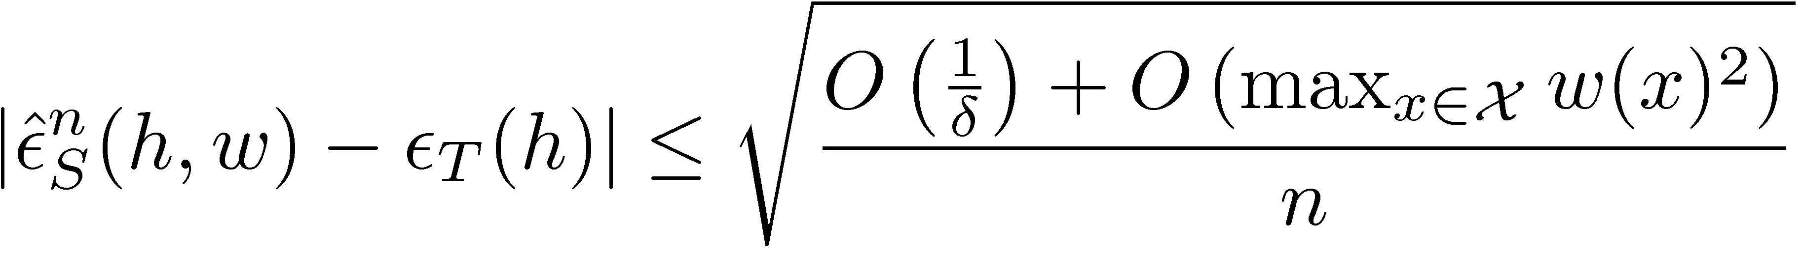
Rates for Re-weighted Learning
Adapted from Gretton et al.

Slide 25

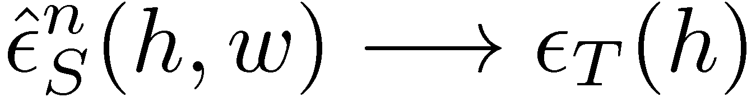

Sample Selection Bias Summary
Two Key Assumptions
Advantage
Optimal target predictor without labeled target data

Slide 26
Sample Selection Bias Summary
Two Key Assumptions
Advantage
Disadvantage

Slide 27
Sample Selection Bias References
http://adaptationtutorial.blitzer.com/references/
[1] J. Heckman. Sample Selection Bias as a Specification Error. 1979.
[2] A. Gretton et al. Covariate Shift by Kernel Mean Matching. 2008.
[3] C. Cortes et al. Sample Selection Bias Correction Theory. 2008
[4] S. Bickel et al. Discriminative Learning Under Covariate Shift. 2009.

Slide 28
Tutorial Outline
Notation and Common Concepts
Semi-supervised Adaptation
Covariate shift
Learning Shared Representations
Supervised Adaptation
Feature-Based Approaches
Parameter-Based Approaches
Open Questions and Uncovered Algorithms

Slide 29

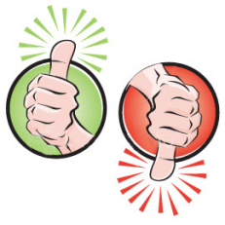


Unshared Support in the Real World
Avante Deep Fryer; Black
Title: lid does not work well...
I love the way the Tefal deep fryer cooks, however, I am returning my second one due to a defective lid closure. The lid may close initially, but after a few uses it no longer stays closed. I won’t be buying this one again.
?
Running with Scissors
Title: Horrible book, horrible.
This book was horrible. I read half, suffering from a headache the entire time, and eventually i lit it on fire. 1 less copy in the world. Don't waste your money. I wish i had the time spent reading this book back. It wasted my life
?
.
.
.
.
.
.
.
.
.
.
.
.
?

Slide 30
Unshared Support in the Real World
Avante Deep Fryer; Black
Title: lid does not work well...
I love the way the Tefal deep fryer cooks, however, I am returning my second one due to a defective lid closure. The lid may close initially, but after a few uses it no longer stays closed. I won’t be buying this one again.
?
Running with Scissors
Title: Horrible book, horrible.
This book was horrible. I read half, suffering from a headache the entire time, and eventually i lit it on fire. 1 less copy in the world. Don't waste your money. I wish i had the time spent reading this book back. It wasted my life
?
Error increase: 13% → 26%
.
.
.
.
.
.
.
.
.
.
.
.
?

Slide 31
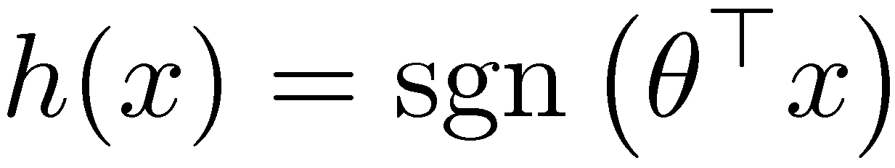
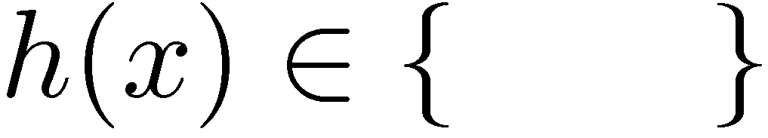



Linear Regression for Rating Prediction
excellent
great
fascinating
.
.
.
.
.
.
3 0 0 1 0 0 1
.
.
.
.
.
.
0.5 1 -1.1 2 -0.3 0.1 1.5

Slide 32

Coupled Subspaces
No Shared Support
Single Good Linear Hypothesis
Stronger than

Slide 33

Coupled Subspaces
No Shared Support
Single Good Linear Hypothesis
Coupled Representation Learning

Slide 34
Single Good Linear Hypothesis?
Adaptation Squared Error
Target Source | Books | Kitchen
Books | 1.35
Kitchen |  | 1.19
Both

Slide 35
Single Good Linear Hypothesis?
Adaptation Squared Error
Target Source | Books | Kitchen
Books | 1.35
Kitchen |  | 1.19
Both | 1.38 | 1.23

Slide 36
Single Good Linear Hypothesis?
Adaptation Squared Error
Target Source | Books | Kitchen
Books | 1.35 | 1.68
Kitchen | 1.80 | 1.19
Both | 1.38 | 1.23

Slide 37
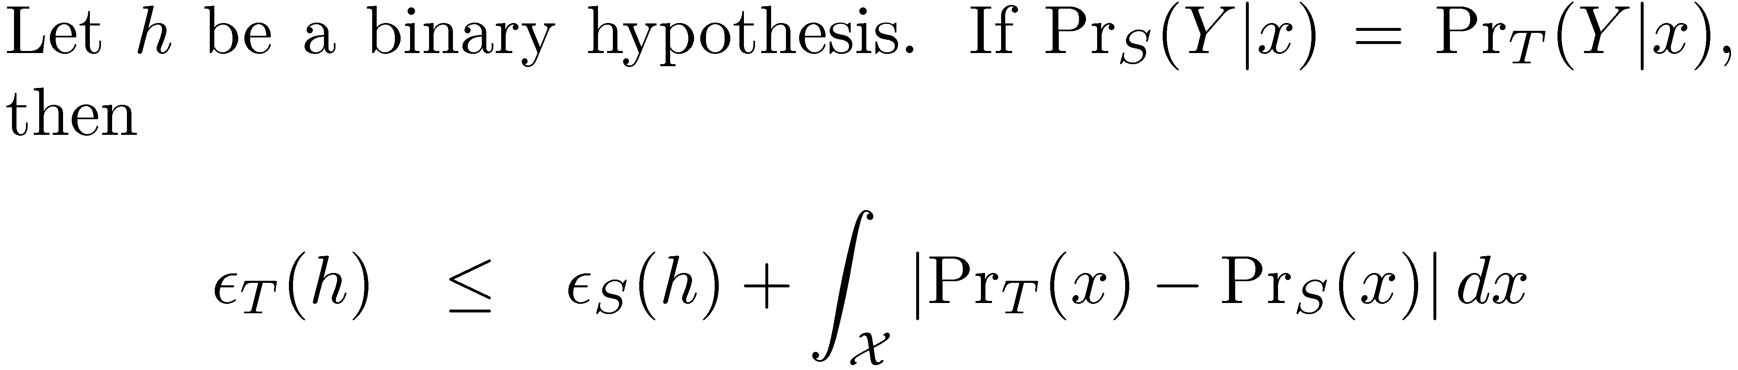
A bound on the adaptation error
What if a single good hypothesis exists?
A better discrepancy than total variation?

Slide 38


A generalized discrepancy distance
Measure how hypotheses make mistakes
Linear, binary discrepancy region

Slide 39
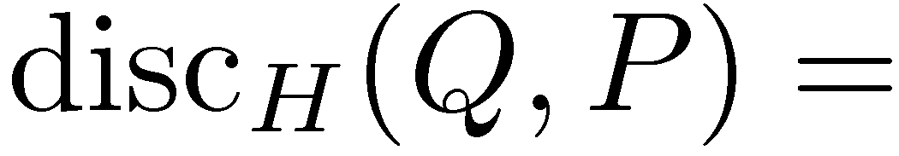
A generalized discrepancy distance
Measure how hypotheses make mistakes
low
low
high

Slide 40
Discrepancy vs. Total Variation
Discrepancy
Total Variation
Computable from finite samples.
Not computable in general

Slide 41
Discrepancy vs. Total Variation
Discrepancy
Total Variation
Computable from finite samples.
Not computable in general

Slide 42
Discrepancy vs. Total Variation
Discrepancy
Total Variation
Computable from finite samples.
Not computable in general
Low?

Slide 43
Discrepancy vs. Total Variation
Discrepancy
Total Variation
Computable from finite samples.
Not computable in general
High?

Slide 44
Discrepancy vs. Total Variation
Discrepancy
Total Variation
Computable from finite samples.
Not computable in general
High?
Related to hypothesis class
Unrelated to hypothesis class

Slide 45
Discrepancy vs. Total Variation
Discrepancy
Total Variation
Computable from finite samples.
Not computable in general
High?
Related to hypothesis class
Unrelated to hypothesis class
Bickel covariate shift algorithm heuristically minimizes both measures

Slide 46
Is Discrepancy Intuitively Correct?
4 domains: Books, DVDs, Electronics, Kitchen
B&D, E&K Shared Vocabulary
B&D: fascinating, boring
E&K: super easy, bad quality
Target Error Rate
Approximate Discrepancy
Notes:
Say Proxy (H\Delta H)-distance is correlated with the adaptation loss. In particular, note that the two edges from the graph which have low adaptation loss (high score) in fact have low proxy H\Delta H distance

Slide 47
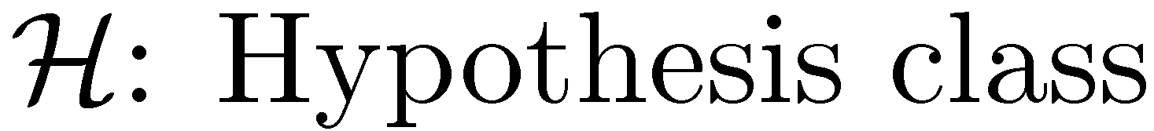
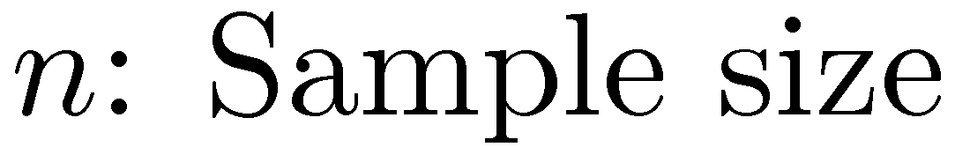
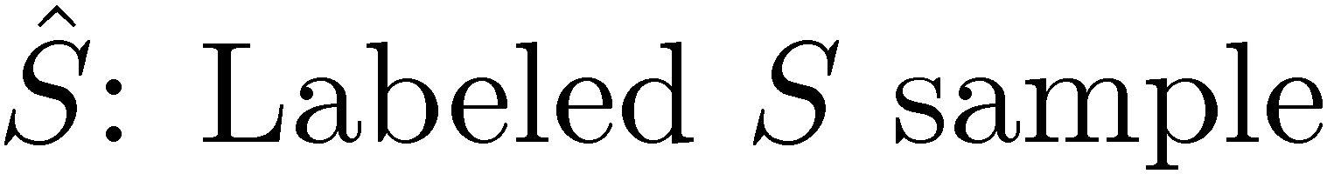

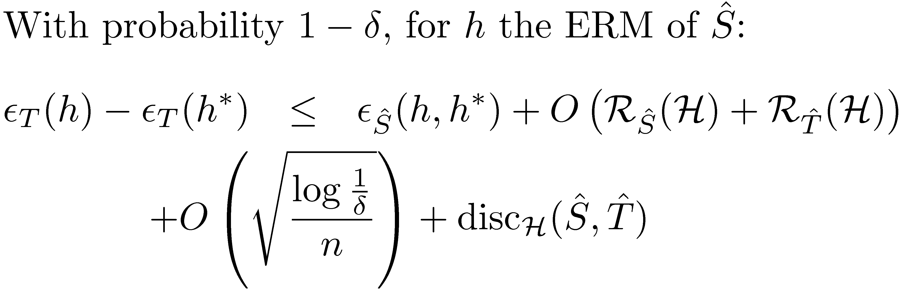
A new adaptation bound
Notes:
Say: If there is some good hypothesis for both domains, then this bound tells how well you can learn from only source labeled data

Slide 48


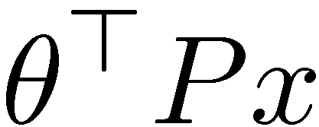

Representations and the Bound
Linear Hypothesis Class:
Hypothesis classes from projections :
30
1001
30
1001
.
.
.
.
.
.

Slide 49


Representations and the Bound
Linear Hypothesis Class:
Hypothesis classes from projections :
30
1001
.
.
.
Goals for
Minimize divergence

Slide 50


Learning Representations: Pivots
Source
Target
Pivot words
fantastic
highly recommended
fascinating
boring
read half
couldn’t put it down
defective
sturdy
leaking
like a charm
waste of money
horrible

Slide 51
Predicting pivot word presence
Do not buy
An absolutely great purchase
.
.
.
?
A sturdy deep fryer

Slide 52
Predicting pivot word presence
Do not buy the Shark portable steamer. The trigger mechanism is defective.
An absolutely great purchase
.
.
.
?
A sturdy deep fryer

Slide 53
Predicting pivot word presence
Do not buy the Shark portable steamer. The trigger mechanism is defective.
An absolutely great purchase. . . . This blender is incredibly sturdy.
Predict presence of pivot words
.
.
.
great
great
great
?
A sturdy deep fryer

Slide 54
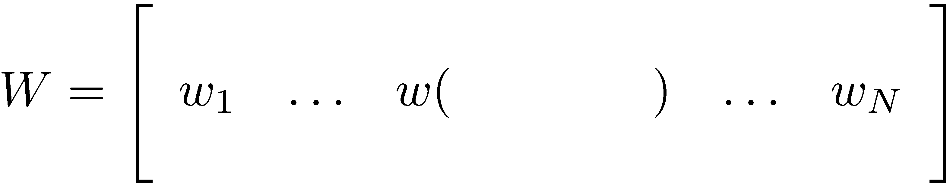
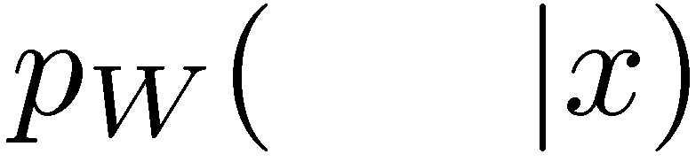
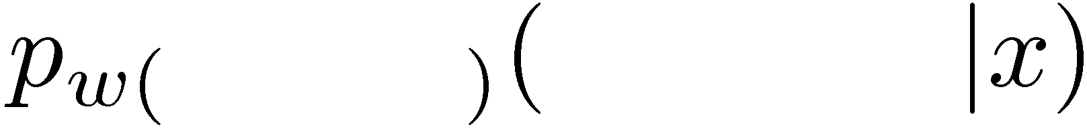
Finding a shared sentiment subspace
highly recommend
highly recommend
generates N new features
: “Did highly recommend appear?”
Sometimes predictors capture non-sentiment information
pivots
highly recommend
highly
recommend
great

Slide 55
Finding a shared sentiment subspace
highly recommend
highly recommend
generates N new features
: “Did highly recommend appear?”
Sometimes predictors capture non-sentiment information
pivots
highly
recommend
I
highly recommend
great

Slide 56
Finding a shared sentiment subspace
highly recommend
highly recommend
generates N new features
: “Did highly recommend appear?”
Sometimes predictors capture non-sentiment information
pivots
highly recommend
highly
recommend
wonderful
great

Slide 57


Finding a shared sentiment subspace
Let be a basis for the
subspace of best fit to
highly recommend
highly recommend
generates N new features
: “Did highly recommend appear?”
Sometimes predictors capture non-sentiment information
pivots
highly recommend
highly
recommend
wonderful
great
Notes:
Don’t say you want to be wrong. Should be high. Why do words appear? Syntactic, semantic, topical, & sentiment reasons. But we’re not interested in syntax. For example, it ignores position
Explicitly say *why* it’s denoising

Slide 58
Finding a shared sentiment subspace
Let be a basis for the
subspace of best fit to
captures sentiment
variance in
highly recommend
generates N new features
: “Did highly recommend appear?”
Sometimes predictors capture non-sentiment information
pivots
( highly recommend, great )
highly recommend
highly
recommend

Slide 59


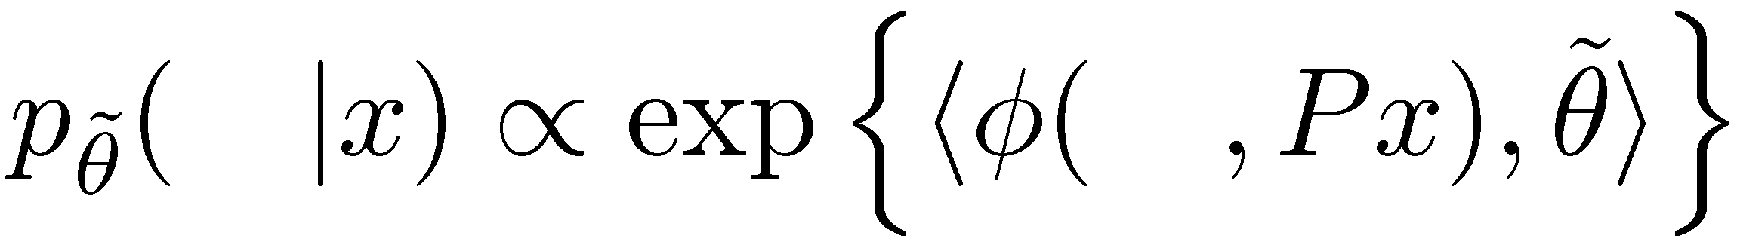
P projects onto shared subspace
Source
Target

Slide 60
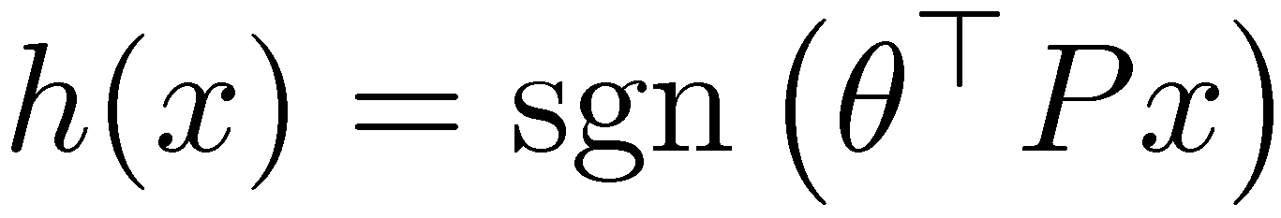
P projects onto shared subspace
Source
Target

Slide 61
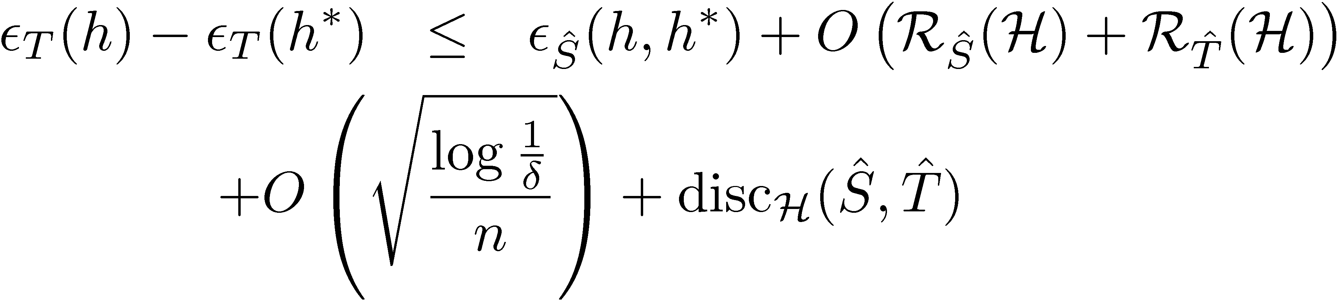
Correlating Pieces of the Bound
Component Projection | Discrepancy | Source Huber Loss | Target Error
Idenitity | 1.796 | 0.003 | 0.253
Notes:
Say Proxy (H\Delta H)-distance is correlated with the adaptation loss. In particular, note that the two edges from the graph which have low adaptation loss (high score) in fact have low proxy H\Delta H distance

Slide 62
Correlating Pieces of the Bound
Component Projection | Discrepancy | Source Huber Loss | Target Error
Idenitity | 1.796 | 0.003 | 0.253
Random | 0.223 | 0.254 | 0.561
Notes:
Say Proxy (H\Delta H)-distance is correlated with the adaptation loss. In particular, note that the two edges from the graph which have low adaptation loss (high score) in fact have low proxy H\Delta H distance

Slide 63
Correlating Pieces of the Bound
Component Projection | Discrepancy | Source Huber Loss | Target Error
Idenitity | 1.796 | 0.003 | 0.253
Random | 0.223 | 0.254 | 0.561
Coupled Projection | 0.211 | 0.07 | 0.216
Notes:
Say Proxy (H\Delta H)-distance is correlated with the adaptation loss. In particular, note that the two edges from the graph which have low adaptation loss (high score) in fact have low proxy H\Delta H distance

Slide 64
Target Accuracy: Kitchen Appliances
Source Domain
Notes:
Fix development here. Start with ideal bar on the end.

Slide 65
Target Accuracy: Kitchen Appliances
87.7%
87.7%
87.7%
Source Domain
Notes:
Fix development here. Start with ideal bar on the end.

Slide 66
Target Accuracy: Kitchen Appliances
87.7%
87.7%
87.7%
84.0%
74.5%
74.0%
Source Domain
Notes:
Fix development here. Start with ideal bar on the end.

Slide 67
Target Accuracy: Kitchen Appliances
87.7%
87.7%
87.7%
85.9%
84.0%
81.4%
78.9%
74.5%
74.0%
Source Domain
Notes:
Fix development here. Start with ideal bar on the end.

Slide 68
Adaptation Error Reduction
87.7%
87.7%
87.7%
85.9%
84.0%
81.4%
78.9%
36% reduction in error due to adaptation
74.5%
74.0%
Source Domain
Notes:
Fix development here. Start with ideal bar on the end.

Slide 69
Visualizing (books & kitchen)
negative vs. positive
books
engaging
must_read
plot
<#>_pages
predictable
fascinating
grisham
poorly_designed
awkward_to
espresso
years_now
the_plastic
leaking
are_perfect
a_breeze
kitchen

Slide 70
Representation References
http://adaptationtutorial.blitzer.com/references/
[1] Blitzer et al. Domain Adaptation with Structural Correspondence Learning. 2006.
[2] S. Ben-David et al. Analysis of Representations for Domain Adaptation. 2007.
[3] J. Blitzer et al. Domain Adaptation for Sentiment Classification. 2008.
[4] Y. Mansour et al. Domain Adaptation: Learning Bounds and Algorithms. 2009.

Slide 71
Tutorial Outline
Notation and Common Concepts
Semi-supervised Adaptation
Covariate shift
Learning Shared Representations
Supervised Adaptation
Feature-Based Approaches
Parameter-Based Approaches
Open Questions and Uncovered Algorithms

Slide 72
Feature-based approaches
Cell-phone domain:
“horrible” is bad
“small” is good
Hotel domain:
“horrible” is bad
“small” is bad
Key Idea: Share some features (“horrible”)‏
Don't share others (“small”)‏
(and let an arbitrary learning algorithm
decide which are which)‏

Slide 73
Feature Augmentation
In feature-vector lingo:
x → ‹x, x, 0› (for source domain)‏
x → ‹x, 0, x› (for target domain)‏
The phone is small The hotel is small
W:the
W:phone
W:is
W:small
W:the
W:hotel
W:is
W:small
Original
Features
S:the
S:phone
S:is
S:small
Augmented
Features
T:the
T:hotel
T:is
T:small

Slide 74
A Kernel Perspective
In feature-vector lingo:
x → ‹x, x, 0› (for source domain)‏
x → ‹x, 0, x› (for target domain)‏
2K(x,z) if x,z from same domain
K(x,z) otherwise
We have ensured SGH & destroyed shared support
K^{aug}(x,z) =

Slide 75
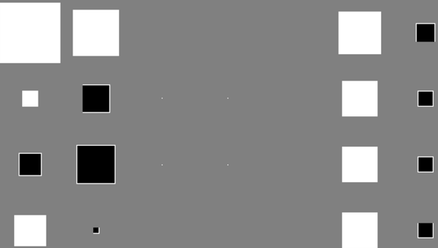
Named Entity Rec.: /bush/
Conversations
General
BC-news
Newswire
Weblogs
Usenet
Telephone
Person
Geo-political
entity
Organization
Location

Slide 76
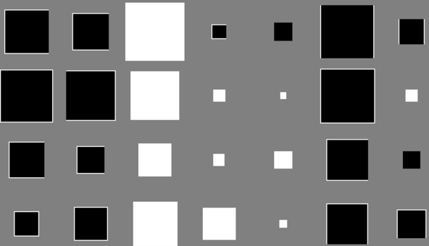
Named Entity Rec.: p=/the/
Conversations
General
BC-news
Newswire
Weblogs
Usenet
Telephone
Person
Geo-political
entity
Organization
Location

Slide 77
Some experimental results
Task Dom SrcOnly TgtOnly Baseline Prior Augment
bn 4.98 2.37 2.11 (pred) 2.06 1.98
bc 4.54 4.07 3.53 (weight) 3.47 3.47
ACE- nw 4.78 3.71 3.56 (pred) 3.68 3.39
NER wl 2.45 2.45 2.12 (all) 2.41 2.12
un 3.67 2.46 2.10 (linint) 2.03 1.91
cts 2.08 0.46 0.40 (all) 0.34 0.32
CoNLL tgt 2.49 2.95 1.75 (wgt/li) 1.89 1.76
PubMed tgt 12.02 4.15 3.95 (linint) 3.99 3.61
CNN tgt 10.29 3.82 3.44 (linint) 3.35 3.37
wsj 6.63 4.35 4.30 (weight) 4.27 4.11
swbd3 15.90 4.15 4.09 (linint) 3.60 3.51
br-cf 5.16 6.27 4.72 (linint) 5.22 5.15
Tree br-cg 4.32 5.36 4.15 (all) 4.25 4.90
bank- br-ck 5.05 6.32 5.01 (prd/li) 5.27 5.41
Chunk br-cl 5.66 6.60 5.39 (wgt/prd) 5.99 5.73
br-cm 3.57 6.59 3.11 (all) 4.08 4.89
br-cn 4.60 5.56 4.19 (prd/li) 4.48 4.42
br-cp 4.82 5.62 4.55 (wgt/prd/li) 4.87 4.78
br-cr 5.78 9.13 5.15 (linint) 6.71 6.30
Treebank- brown 6.35 5.75 4.72 (linint) 4.72 4.65

Slide 78
Some Theory
Can bound expected target error:
Average training error
Number of source examples
Number of
target examples
Notes:
HD: make notation consistent with John’s

Slide 79
Feature Hashing
Feature augmentation creates (K+1)D parameters
Too big if K>>20, but very sparse!
Feat. Aug.
1 2 0 4 0 1
1204 01 1204 01
Hashing
2 1 4 4 1 1 3

Slide 80
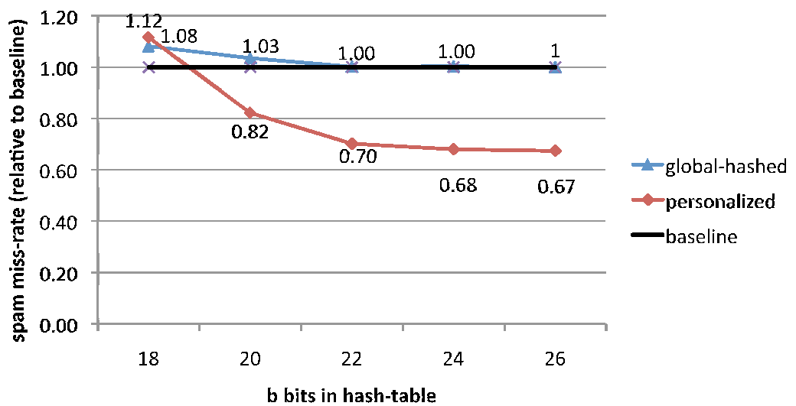
Hash Kernels
How much contamination between domains?
Weights excluding domain u
Hash vector for
domain u
Target (low) dimensionality

Slide 81
Semi-sup Feature Augmentation
For labeled data:
(y, x) → (y, ‹x, x, 0›) (for source domain)‏
(y, x) → (y, ‹x, 0, x›) (for target domain)‏
What about unlabeled data?
Encourage agreement:

Slide 82
Semi-sup Feature Augmentation
For labeled data:
(y, x) → (y, ‹x, x, 0›) (for source domain)‏
(y, x) → (y, ‹x, 0, x›) (for target domain)‏
What about unlabeled data?
(x) → { (+1, ‹0, x, -x›) , (-1, ‹0, x, -x›) }
Encourages agreement on unlabeled data
Akin to multiview learning
Reduces generalization bound
Loss on +ve
Loss on –ve
Loss on unlabeled

Slide 83
Feature-based References
T. Evgeniou and M. Pontil. Regularized Multi-task Learning (2004).
H. Daumé III, Frustratingly Easy Domain Adaptation. 2007.
K. Weinberger, A. Dasgupta, J. Langford, A. Smola, J. Attenberg. Feature Hashing for Large Scale Multitask Learning. 2009.
A. Kumar, A. Saha and H. Daumé III, Frustratingly Easy Semi-Supervised Domain Adaptation. 2010.

Slide 84
Tutorial Outline
Notation and Common Concepts
Semi-supervised Adaptation
Covariate shift
Learning Shared Representations
Supervised Adaptation
Feature-Based Approaches
Parameter-Based Approaches
Open Questions and Uncovered Algorithms

Slide 85
A Parameter-based Perspective
Instead of duplicating features, write:
And regularize and toward zero

Slide 86
Sharing Parameters via Bayes
N data points
w is regularized to zero
Given x and w, we predict y
0
w
N
y
x

Slide 87
Sharing Parameters via Bayes
0
Train model on source domain, regularized toward zero
Train model on target domain, regularized toward source domain
w _{s}
w _{s}
N_{s}
w _{t}
y
N_{t}
y
x
x

Slide 88
Sharing Parameters via Bayes
0
Separate weights for each domain
Each regularized toward w₀
w₀ regularized toward zero
w ₀
w _{s}
w _{t}
N_{s}
N_{t}
y
y
x
x

Slide 89
Sharing Parameters via Bayes
w₀ ~ Nor(0, ρ²)
w_{k} ~ Nor(w₀, σ²)
0
Separate weights for each domain
Each regularized toward w₀
w₀ regularized toward zero
Can derive “augment” as an approximation to this model
Non-linearize:
w₀ ~ GP(0, K)
w_{k} ~ GP(w₀, K)
w ₀
K
Cluster Tasks:
w₀ ~ Nor(0, σ²)
w_{k} ~ DP(Nor(w₀, ρ²), α)
w _{k}
N_{k}
y
x

Slide 90

Not all domains created equal
Would like to infer tree structure automatically
Tree structure should be good for the task
Want to simultaneously infer tree structure and parameters

Slide 91
Kingman’s Coalescent
A standard model for the genealogy of a population
Each organism has exactly one parent (haploid)
Thus, the genealogy is a tree

Slide 92
A distribution over trees

Slide 93
A distribution over trees

Slide 94
A distribution over trees

Slide 95
A distribution over trees

Slide 96
A distribution over trees

Slide 97
A distribution over trees

Slide 98
A distribution over trees

Slide 99
A distribution over trees

Slide 100
A distribution over trees

Slide 101
A distribution over trees

Slide 102
Coalescent as a graphical model

Slide 103
Coalescent as a graphical model

Slide 104
Coalescent as a graphical model

Slide 105
Coalescent as a graphical model

Slide 106

Efficient Inference
Construct trees in a bottom-up manner
Greedy: At each step, pick optimal pair (maximizes joint likelihood) and time to coalesce (branch length)
Infer values of internal nodes by belief propagation

Slide 107
Not all domains created equal
Message passing on coalescent tree; efficiently done by belief propagation
0
Inference by EM:
E: compute expectations over weights
M: maximize tree structure
w ₀
K
w _{k}
Greedy agglomerative clustering algorithm
N_{k}
y
x

Slide 108
Data tree versus inferred tree

Slide 109
Some experimental results

Slide 110
Parameter-based References
O. Chapelle and Z. Harchaoui. A machine learning approach to conjoint analysis. NIPS, 2005.
K. Yu, V. Tresp, and A. Schwaighofer. Learning Gaussian processes from multiple tasks. ICML, 2005.
Y. Xue, X. Liao, L. Carin, and B. Krishnapuram. Multi-task learning for classication with Dirichlet process priors. JMLR, 2007.
H. Daumé III. Bayesian Multitask Learning with Latent Hierarchies. UAI 2009.

Slide 111
Tutorial Outline
Notation and Common Concepts
Semi-supervised Adaptation
Covariate shift
Learning Shared Representations
Supervised Adaptation
Feature-Based Approaches
Parameter-Based Approaches
Open Questions and Uncovered Algorithms

Slide 112



Theory and Practice
Hypothesis classes from projections :
30
1001
.
.
.
Minimize divergence
2)

Slide 113

Open Questions
Matching Theory and Practice
Theory does not exactly suggest what practitioners do
Prior Knowledge
Cross-Lingual Grammar Projection
F2-F1
Speech Recognition
/i/
/e/
/i/
/e/
F1-F0

Slide 114
More Semi-supervised Adaptation
http://adaptationtutorial.blitzer.com/references/
Self-training and Co-training
[1] D. McClosky et al. Reranking and Self-Training for Parser Adaptation. 2006.
[2] K. Sagae & J. Tsuji. Dependency Parsing and Domain Adaptation with LR Models and Parser Ensembles. 2007.
Structured Representation Learning
[3] F. Huang and A. Yates. Distributional Representations for Handling Sparsity in Supervised Sequence Labeling. 2009.

Slide 115
What is a domain anyway?
Time?
News the day I was born vs news today?
News yesterday vs news today?
Space?
News back home vs news in Haifa?
News in Tel Aviv vs news in Haifa?
Do my data even come with a domain specified?
Suggest a continuous structure
Stream of <x,y,d> data
with y and d sometimes hidden?

Slide 116



We’re all domains: personalization
adapt learn across millions of “domains”?
share enough information to be useful?
share little enough information to be safe?
avoid negative transfer?
avoid DAAM (domain adaptation spam)?

Slide 117
Thanks
Questions?

